Slide 1
ASP.NET Web API
Jon Galloway
Tech Evangelist
ASP.NET / Azure

Slide 2
Major Differences
Integrated Controller (no more ApiController)
Model Binding
Formatters
Pipeline Customization

Slide 3
Integrated Controller
No more ApiController
Any controller action can return views or data

Slide 4
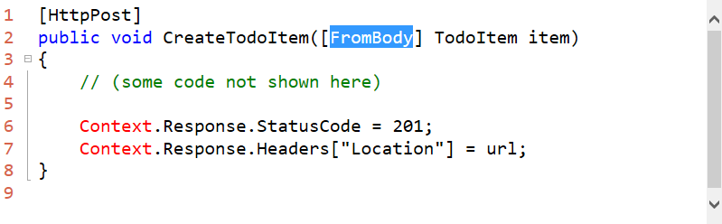
Model Binding
Binding to complex types is no longer explicit
Must use [FromBody] attribute

Slide 5
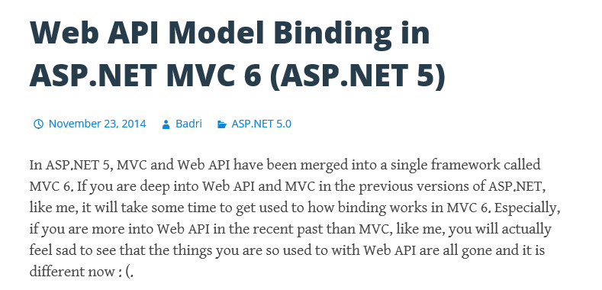
Action Method | Request Message | Binding Result
public void Post(string name) | POST http://localhost:10725/api/values?name=23 HTTP/1.1 Content-Type: application/x-www-form-urlencoded Host: localhost:10725 Content-Length: 7 name=34 | name is set to 23, since query string wins over form data.
public void Post([FromForm]string name) | POST http://localhost:10725/api/values?name=23 HTTP/1.1 Content-Type: application/x-www-form-urlencoded Host: localhost:10725 Content-Length: 7 name=34 | name is set to 34, since you are specifically asking for it through [FromForm].
public void Post(string name) | POST http://localhost:10725/api/values HTTP/1.1 Content-Type: application/x-www-form-urlencoded Host: localhost:10725 Content-Length: 7 name=34 | name is set to 34. Despite being simple type, name is set from body by default, because the body is form data (one of MVC’s favorites
http://bit.ly/1JPji41
https://lbadri.wordpress.com/2014/11/23/web-api-model-binding-in-asp-net-mvc-6-asp-net-5/

Slide 6
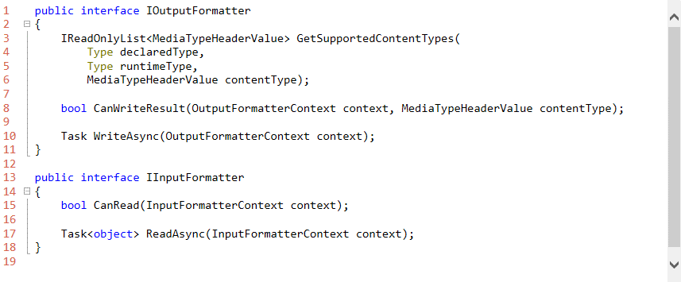
Formatters
No longer bi-directional - now uni-directional

Slide 7
Included Input Formatters
JsonInputFormatter – based on JSON.NET
XmlSerializerInputFormatter – based on XmlSerializer (in the box, but not registered by default)
XmlDataContractSerializerInputFormatter – based on DataContractSerializer
http://www.strathweb.com/2014/11/formatters-asp-net-mvc-6/

Slide 8
Included Output Formatters
JsonOutputFormatter – based on JSON.NET
XmlSerializerOutputFormatter – based on XmlSerializer (in the box, but not registered by default)
XmlDataContractSerializerOutputFormatter – based on DataContractSerializer
TextPlainFormatter – used to force a string into a text/plain content type
HttpNoContentOutputFormatter – used to force 204 status code for null action return
HttpNotAcceptableOutputFormatter – used to force 406 status code if no appropriate formatter can be selected to handle the request (in the box, but not registered by default)
http://www.strathweb.com/2014/11/formatters-asp-net-mvc-6/

Slide 9
WebApiCompatShim
Enables ASP.NET Web API 2 Conventions and Objects
ApiController
DefaultContentNegotiator
HttpRequestMessage (binding and extension)
http://www.strathweb.com/2015/01/migrating-asp-net-web-api-mvc-6-exploring-web-api-compatibility-shim/

Slide 10

Recommended NDC Session
Migrating your API from Web API 2 to MVC 6
Filip W
18 June 2015 11:40 - 12:40
While Microsoft is calling their new web framework "MVC 6" and branding it as a unified successor of MVC / Web API / Web Pages, the reality is much more complicated than that. The newASP.NET 5 alone is a completely different managed runtime, which results in plenty of changes, compatibility issues and necessary adjustments when trying to bring your old application over to the new world. On top of that MVC 6 introduces plenty of changes. While controllers in "old" and "new" world may look similarly, a lot of core concepts that you might have been used to when working with Web API projects have changed, and finding corresponding ones is a tricky, and often frustrating, task. This talk will draw parallels between the Web API framework pipeline that you might be used to (MessageHandlers, Filters, Selectors, Formatters etc), to the one which are part of MVC 6, and explore the techniques you can use when migrating a Web API project to MVC 6 - hopefully easing your transition into the next generation of ASP.NET.

